Slide 1

JOURNAL CLUB / ENVIRONMENTAL BIOTECHNOLOGY
Ciprofloxacin
removal through
algal–bacterial
partnerships
Performance, microbial responses
and the proposed mechanism
Yongrui Pi, Yan Li, Wenpeng Jia, Yongzheng Tang
Journal of Hazardous Materials · 2025
DOI: 10.1016/j.jhazmat.2025.138780
Conceptual illustration · not experimental imagery
Notes:
This journal-club presentation examines the study by Pi and colleagues, not a field deployment. The paper asks how a Chlorella vulgaris-bacteria consortium removes ciprofloxacin hydrochloride and which biological responses accompany removal. The title is shortened for oral presentation. Full title: Enhancing removal performance of ciprofloxacin hydrochloride by Chlorella vulgaris-bacteria consortium: Insights of microbial responses and stoichiometry. Authors: Yongrui Pi, Yan Li, Wenpeng Jia and Yongzheng Tang.
Source: Pi et al. | Journal of Hazardous Materials 494 (2025), 138780. https://doi.org/10.1016/j.jhazmat.2025.138780
The cover illustration is AI-generated and conceptual, not experimental imagery or anatomically validated cell structure.

Slide 2
STUDY DESIGN / CONTROLLED COMPARISONS
Four systems, one seven-day experiment
Does combining algae and bacteria improve CIP removal?
MBC
PM
PB
BG
Algae + bacteria
Algae only
Bacteria only
No cells
0 / 10 / 20 / 40 / 80 mg/L CIP
Sampling: days 1, 3 and 7
25 ± 1 °C 12 h light / 12 h dark
HPLC measures aqueous CIP
Adapted from Methods 2.1–2.3, Pi et al. (2025). CIP: ciprofloxacin hydrochloride.
Notes:
The study compared the microalgae-bacteria consortium (MBC), pure microalgae (PM), pure bacteria (PB), and a blank group without either organism (BG). Chlorella vulgaris was combined with bacteria isolated from a pharmaceutical-plant effluent and acclimated to CIP. The concentration series included a zero-CIP condition and 10, 20, 40 and 80 mg/L. Flasks contained 180 mL BG-11 medium; reported inoculum wet-cell weight was 3.05 g/L. Conditions were 25 ± 1 °C, 4,000 lx, a 12:12 h light-dark cycle and 120 rpm. Samples were collected on days 1, 3 and 7. CIP concentration was measured by HPLC. The diagram and table are an adapted summary, not an original figure.
Source: Pi et al. | Journal of Hazardous Materials 494 (2025), 138780. https://doi.org/10.1016/j.jhazmat.2025.138780

Slide 3
RESULT / SEVEN-DAY FLASK EXPERIMENT
Strong removal, but concentration matters
CIP removal (%)
94.6%
± 0.6 percentage points
Algae + bacteria
10 mg/L CIP · 7 days
Initial CIP concentration (mg/L)
At 20–80 mg/L, reported removal was 60.4–69.6%. Source: Table 1, Pi et al. (2025).
Notes:
The consortium removed 94.6 ± 0.6% at 10 mg/L after seven days. Table 1 reports 69.6 ± 4.5%, 60.4 ± 0.8% and 68.2 ± 1.7% at 20, 40 and 80 mg/L. These are the reported removal percentages, not proof of complete mineralisation. Removal at higher loadings was below the 10 mg/L condition, but the 40-to-80 mg/L sequence was not monotonically decreasing. The chart is editable and is redrawn only from the explicit table values. The text of the paper gives ±1.8% at 80 mg/L, whereas Table 1 gives ±1.7%; the table version is used here. The source does not unambiguously define the ± term in this table, so it is not relabelled as a confidence interval or standard deviation.
Source: Pi et al. | Journal of Hazardous Materials 494 (2025), 138780. https://doi.org/10.1016/j.jhazmat.2025.138780

Slide 4
KINETICS / PUBLISHED MODEL FITS
Higher loading slows the removal kinetics
Rate constant, k (per day)
Half-life (days)
Initial CIP concentration (mg/L), algae + bacteria
Redrawn from Table 1, Pi et al. (2025). Reported fitted values, not raw time-series measurements.
Notes:
For MBC, the fitted pseudo-first-order rate constant fell from 0.42 to 0.13 per day across 10–80 mg/L. The reported half-life increased from 1.66 to 5.23 days. Intermediate constants were 0.16 and 0.15 per day; intermediate half-lives were 4.23 and 4.60 days. These are fitted, rounded source values. Calculating ln(2)/k from the rounded constants will not exactly reproduce every reported half-life; we preserve the published values rather than inventing additional precision. The two charts use separate vertical axes and neither establishes performance outside the experimental conditions.
Source: Pi et al. | Journal of Hazardous Materials 494 (2025), 138780. https://doi.org/10.1016/j.jhazmat.2025.138780

Slide 5
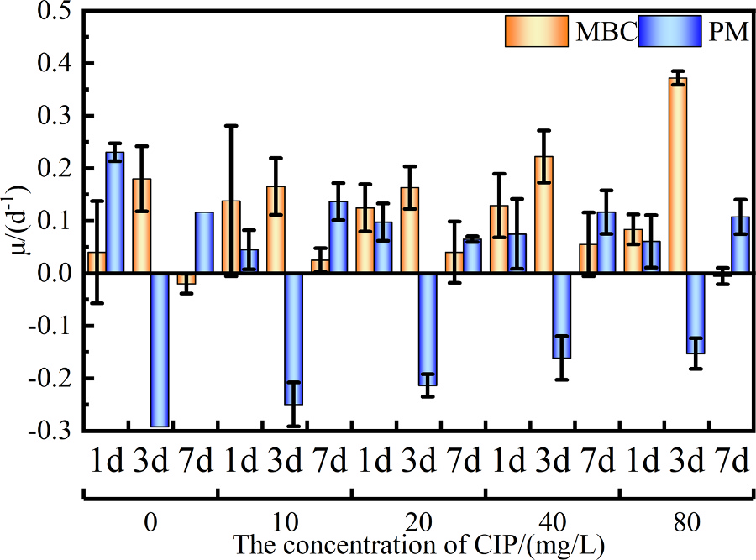
PHYSIOLOGY / ALGAL GROWTH
Co-culture changes the growth response
Under CIP exposure
MBC generally retains
positive growth.
PM shows negative
growth in several
conditions.
The benefit varies over time.
Source: Fig. 2, Pi et al. (2025). Original plot. MBC: algae + bacteria. PM: algae only.
Notes:
Figure 2 compares specific growth rates of Chlorella vulgaris in MBC and PM at days 1, 3 and 7 across the concentration series. PM shows negative growth rates under several CIP-exposed conditions, while MBC generally retains positive growth. This is a time- and concentration-dependent pattern: do not claim that MBC exceeds PM at every time point. The text reports a maximum MBC growth rate of 0.372 ± 0.013 per day at 80 mg/L on day 3. The authors interpret bacterial support as contributing to algal tolerance; that interpretation is not itself an isolated test of each exchange mechanism. The original figure preserves axes, day labels, concentration groups, uncertainty marks and legend.
Source: Pi et al. | Journal of Hazardous Materials 494 (2025), 138780. https://doi.org/10.1016/j.jhazmat.2025.138780

Slide 6
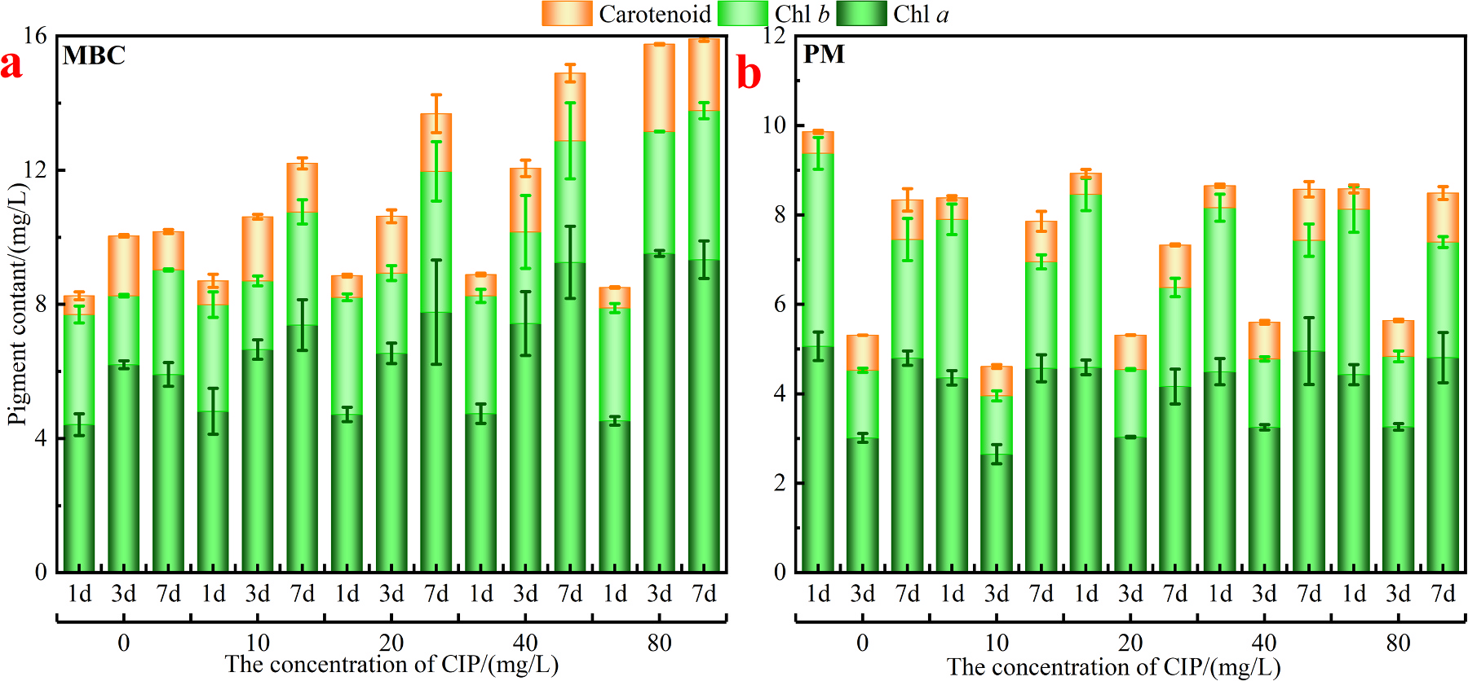
PHYSIOLOGY / PHOTOSYNTHETIC PIGMENTS
Pigment accumulation differs between systems
The consortium accumulates more pigment, a physiological response rather than a direct degradation measure.
Source: Fig. 3a–b, Pi et al. (2025). Original panels with their separate vertical scales retained.
Notes:
Figure 3 shows chlorophyll a, chlorophyll b and carotenoids for MBC and PM. The figure supports higher pigment accumulation in the consortium and a change with time and CIP concentration. Original stacked bars, concentration groupings, day labels and legend are preserved. Pigments are physiological indicators, not direct measurements of how much CIP was chemically degraded. The authors discuss nutrient exchange and gas compensation as explanations, but these specific exchange fluxes were not directly quantified in this figure. Avoid repeating the paper’s erroneous cross-reference to Fig. 4a for pigment results; the relevant plot is Fig. 3.
Source: Pi et al. | Journal of Hazardous Materials 494 (2025), 138780. https://doi.org/10.1016/j.jhazmat.2025.138780

Slide 7
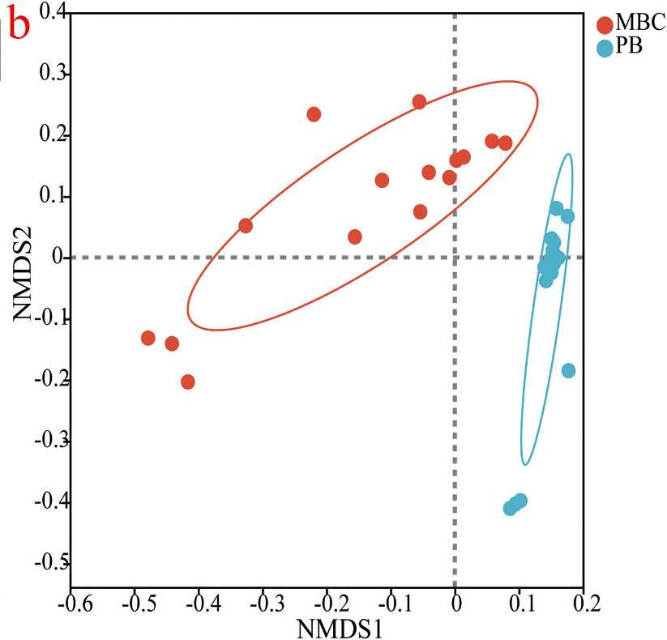
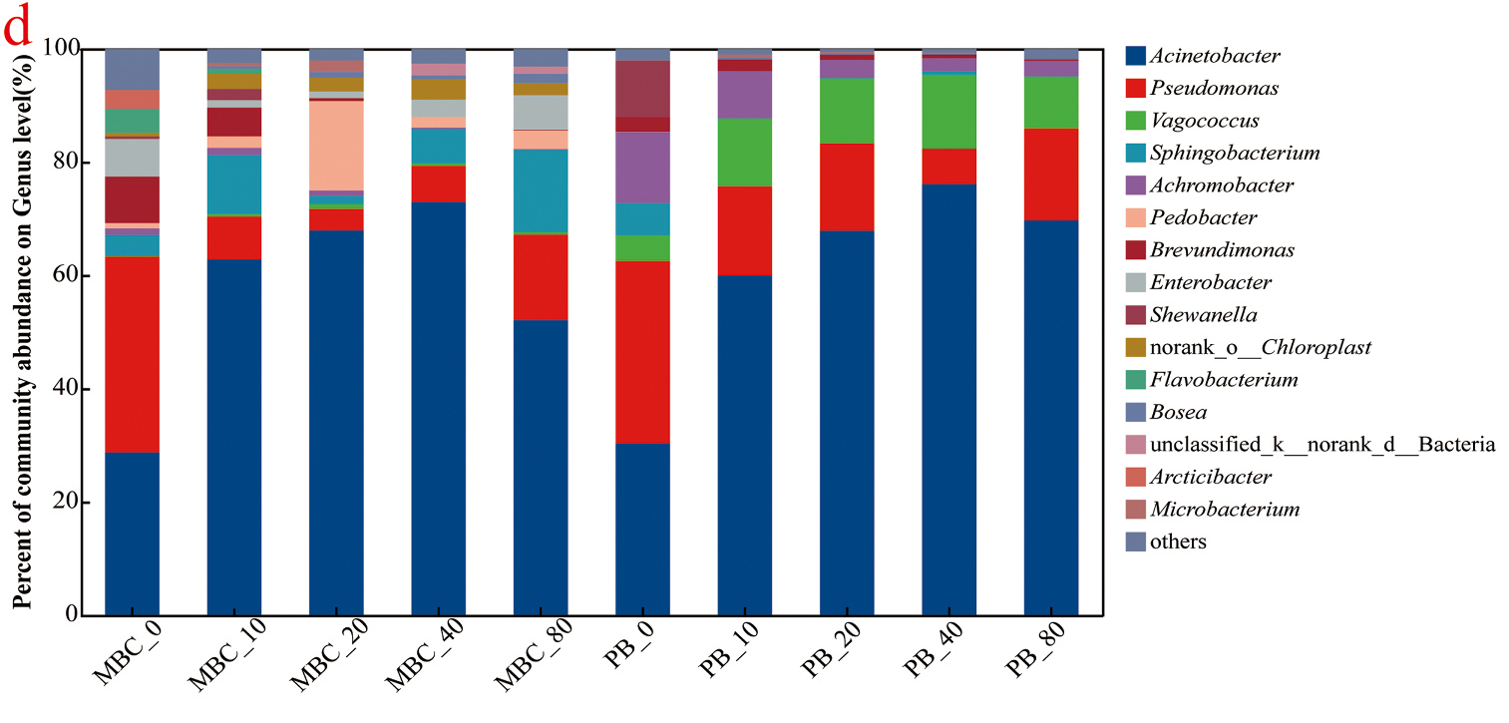
MICROBIAL COMMUNITY / DAY THREE
Co-culture changes community composition
Community separation
Genus-level composition
These community patterns alone do not identify which species causes CIP removal.
Source: Fig. 5b and 5d, Pi et al. (2025). Selected original panels, axes and legends retained.
Notes:
The left panel is the NMDS ordination in Fig. 5b; the right panel is the genus-level relative-abundance plot in Fig. 5d. NMDS means non-metric multidimensional scaling. The figure caption places these community analyses after three days. The consortium and pure-bacteria communities differ, and Acinetobacter is a major genus in the relative-abundance profiles. The authors nominate Acinetobacter johnsonii as a principal contributor, but genus-level relative abundance alone does not establish species-specific degradation activity. Section 2.7 describes 0 and 80 mg/L sampling whereas Fig. 5 includes intermediate concentration labels; that reporting discrepancy is retained as a discussion limitation, not silently reconciled. Panels a, c and e are omitted here to focus on composition and separation, not to reproduce every analysis.
Source: Pi et al. | Journal of Hazardous Materials 494 (2025), 138780. https://doi.org/10.1016/j.jhazmat.2025.138780

Slide 8
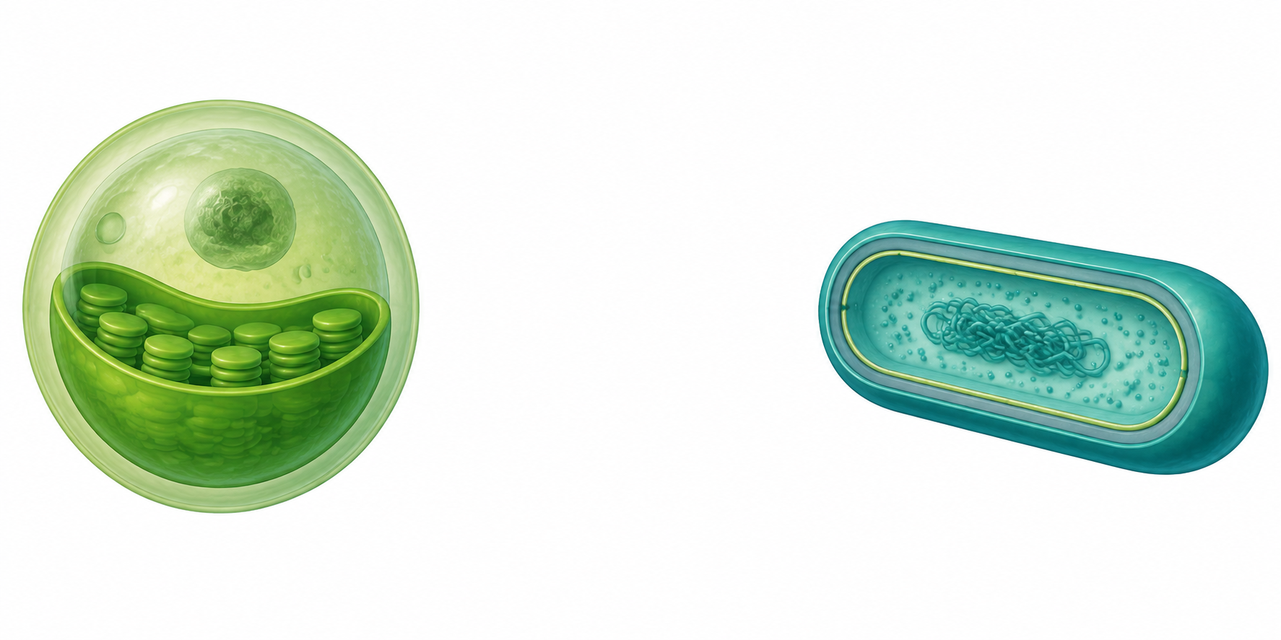
MECHANISM / AUTHORS’ PROPOSED EXPLANATION
The partnership behind the removal response
Chlorella vulgaris
Bacteria
O2 + organic carbon
CO2 + metabolites
Proposed metabolic support
Conceptual redraw, not measured exchange fluxes. Source: Introduction and Fig. 8, Pi et al. (2025).
Notes:
The Introduction describes a proposed mutual support mechanism: algae supply oxygen and dissolved organic carbon, while bacteria supply carbon dioxide and extracellular metabolites. The arrows summarise that explanatory context, not directly measured exchange fluxes. The study measures removal and physiological/community responses. It does not directly verify every exchange arrow. Cell illustrations are AI-generated, not microscopy, not to scale and not validated cell anatomy. Source: Introduction, PDF p. 2, and the mechanistic discussion associated with Fig. 8. Pi et al. (2025), DOI: 10.1016/j.jhazmat.2025.138780.

Slide 9
INTERPRETATION / EVIDENCE BOUNDARIES
What the results establish
MEASURED IN THIS STUDY
STILL NEEDS DIRECT EVIDENCE
Lower aqueous CIP
Complete mineralisation
Changed growth and pigments
Specific exchange mechanisms
Different bacterial communities
Species-specific degradation
Reporting caveats: PM/PB values at 10 mg/L conflict between the table and text.
Community-sampling conditions also differ between Methods and figure labels.
Interpretation of Table 1, Figs. 2–5 and 8, and Methods 2.7. Pi et al. (2025).
Notes:
This slide is an interpretation for group discussion. HPLC disappearance shows removal from the measured aqueous phase, not complete mineralisation by itself. Pigment and stress-enzyme measurements support changes in physiological response but do not individually isolate all exchange mechanisms. 16S community patterns and predicted functions support hypotheses, not proof of species-specific catalytic activity. The methods and figure labels are not wholly consistent for community sampling. For the 10 mg/L controls, Table 1 gives PM 61.4 ± 0.8% and PB 71.3 ± 1.2%, while section 3.1.1 reverses these assignments. This presentation therefore avoids claiming a resolved PM-versus-PB ranking at 10 mg/L. At 80 mg/L, Table 1 reports MBC ±1.7% whereas the prose reports ±1.8%. Neither discrepancy changes the stated MBC maximum, but both matter for reuse.
Source: Pi et al. | Journal of Hazardous Materials 494 (2025), 138780. https://doi.org/10.1016/j.jhazmat.2025.138780

Slide 10
GROUP DISCUSSION / TAKE-HOME MESSAGE
Promising flask results, open mechanistic questions
The consortium removes CIP under controlled conditions.
Its performance depends on the starting concentration.
Next experiment
Which defined co-culture would isolate the bacterial contribution?
Chemical fate
What measurements would separate removal from mineralisation?
Summary and presenter discussion questions based on Pi et al. (2025). DOI: 10.1016/j.jhazmat.2025.138780.
Notes:
The strongest result is the consortium’s conditional removal performance, with 94.6 ± 0.6% at 10 mg/L after seven days. Increasing loading slows the fitted kinetics, and physiological and community observations motivate, but do not fully prove, the proposed mechanism. For group discussion, a controlled isolate or defined co-culture experiment could test causal contributions; tracking transformation products and a carbon balance would help distinguish disappearance from mineralisation. These are proposed follow-up questions, not experiments reported in this paper. The original paper, rather than this shortened deck, should be consulted for methods and contradictory table/prose entries.
Source: Pi et al. | Journal of Hazardous Materials 494 (2025), 138780. https://doi.org/10.1016/j.jhazmat.2025.138780

